Slide 1
AN ANALYSIS ON IMBALANCE WORKLOAD PATTERN IN THE CLOUD CLUSTER TRACE
Zengxiaoran Kang
Dilma Da Silva
Acknowledgement of Funding Source(s) (optional)

Slide 2
Cloud Services Study
Cloud Server Data Set
Tools Applied
Google Borg V3
Tasks and collections scheduling service
Allocating million of services in a global scale
Important function for Google internal operations
Google Cloud Platform
Big Query
Colaboratory Research
Python Jupyter notebook
Feather - light weight storage
Scikit-learn – machine learning
Pandas – data manipulation
Matplotlib, Plotly, Altair (graphing)

Slide 3
When the users submit a job request
Cloud Services Study
Google Borg in User view
job hello_world = {
runtimtime = {cell a} // What cell do I want it to run on?
binary = “program” // What program do I want to run?
args = {additional arguments} // What are some special constraints?
requirements = { // How many resources do I want?
RAM = 1 G
DISK = 10 G
CPU = 1.0
}
}
Borg decides:
Where to run tasks on the actual physical space
How to allocate resources
Installing dependencies
Monitoring tasks’ health

Slide 4
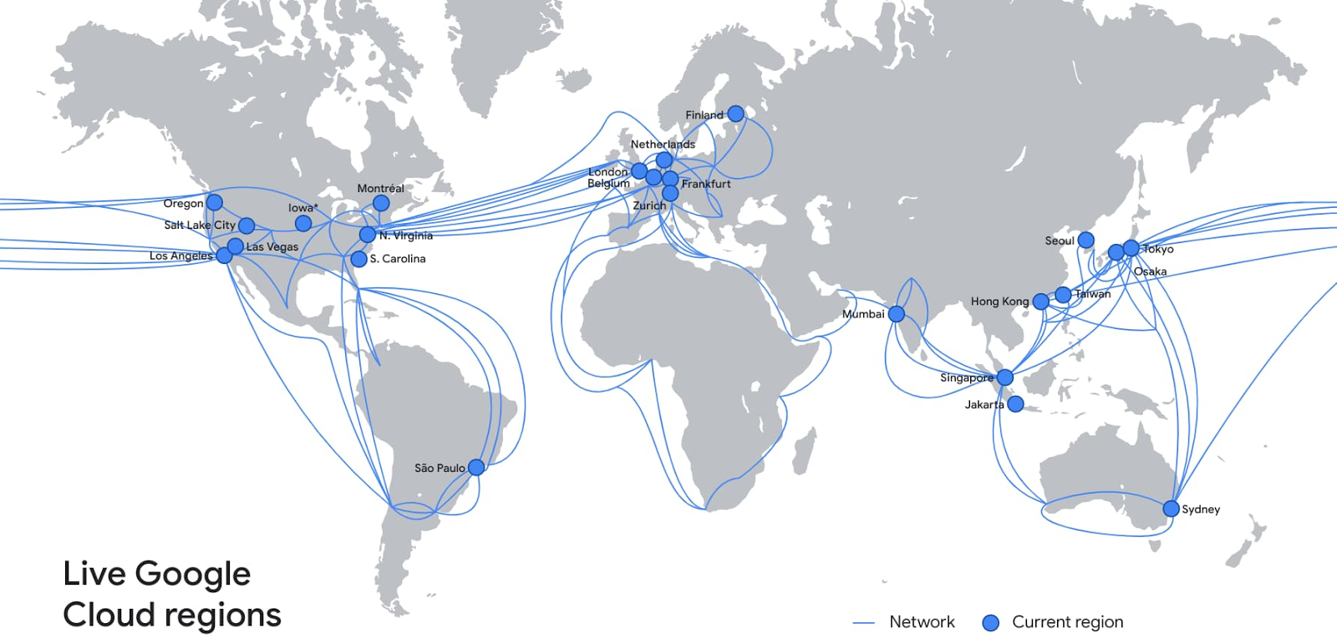



About Borg Infrastructure
Cluster A
more cells
Special-purposed cell
Cluster B
Building
Cluster C
Building
Building
Building
Building
Building
Data Center Site
Figure. Google Cloud region services and Borg Infrastructure
Notes:
Why this is a point? Address importance
Optimizing load balancing is important. “Cost & Profits”
Numbers in thesis

Slide 5
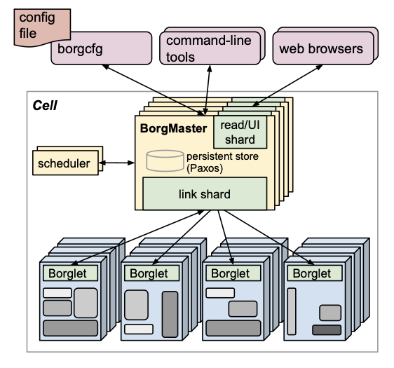
About Borg Scheduler
user
Job
(binary)
Autopilot
Figure. Borg scheduling process
Notes:
Paxos general protocal for consistency
1. compile program
2. Send compiled program’s config. That will send an RPC to the Borg Master. The borg master is a software that runs on each cell. There is several copy
In Paxos, and one of the copy running requests
3. Borg master writes into the persistent store Paxos, and it says got it. Just in case the client break or fail.
4. Sometimes later, the scheduler pick up tasks asynchronously. This thing said there are 10,000 tasks running. Are there?
If not, let’s fix it. It then decides where to put those tasks on the machines and write its decision back to the persistent store in case the scheduler goes away.
5. Later, it talks to the agent software called the Borglet.
The bogrmaster checks on Paxos. Are machines running 10,000 tasks? No, then it sent command to Borglet to get those tasks running.
The whole is designed in away that we can tolerate numbers of failure simultaneously. It creates multiple copies of user’s binary program in case one of those goes wrong.

Slide 6
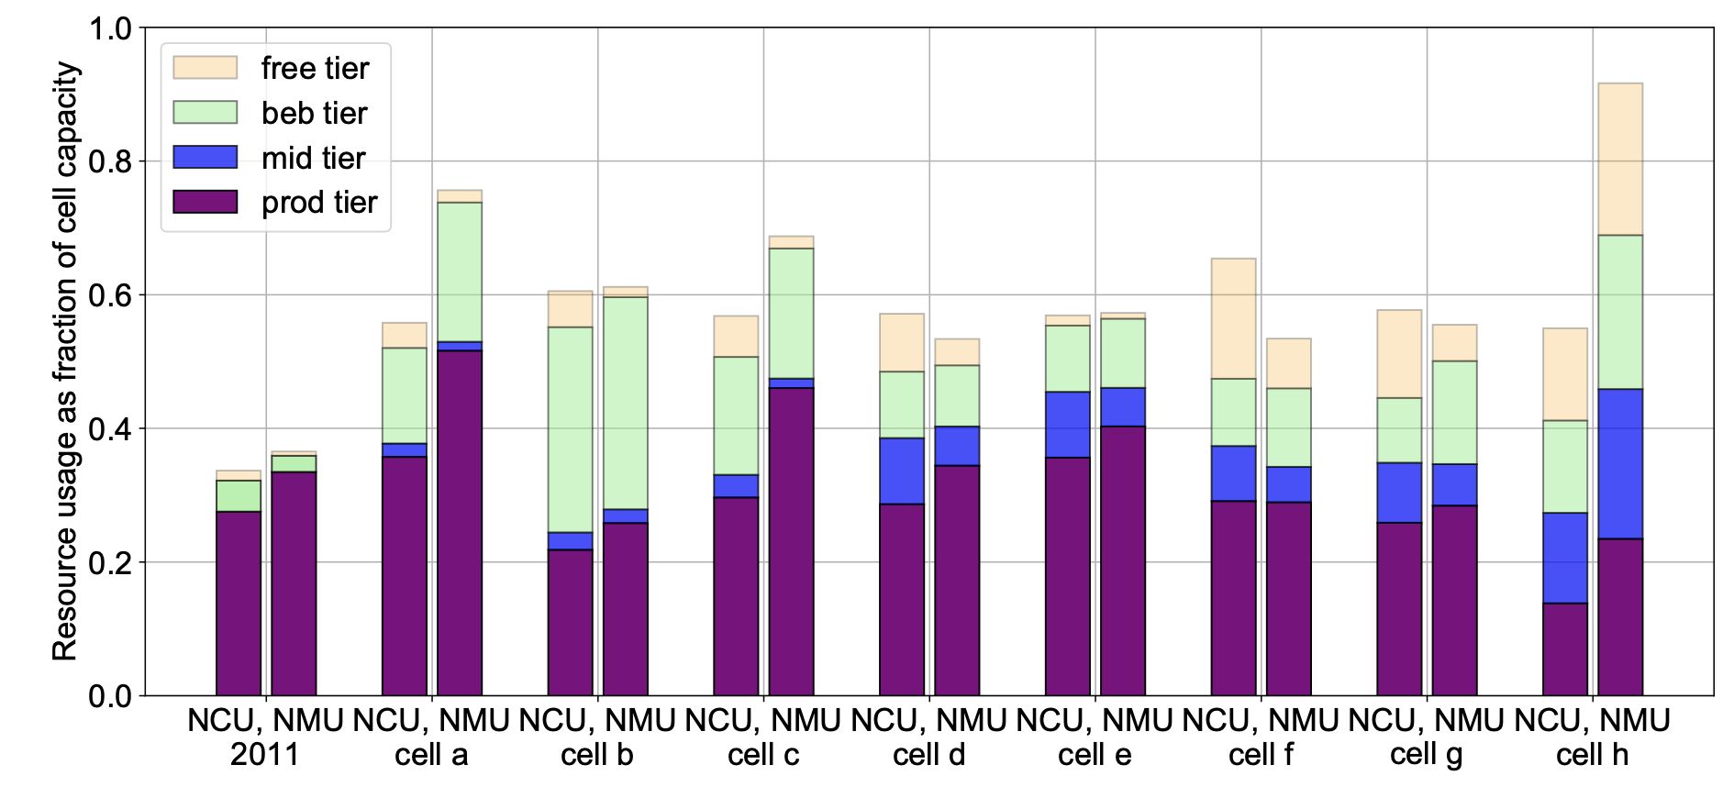
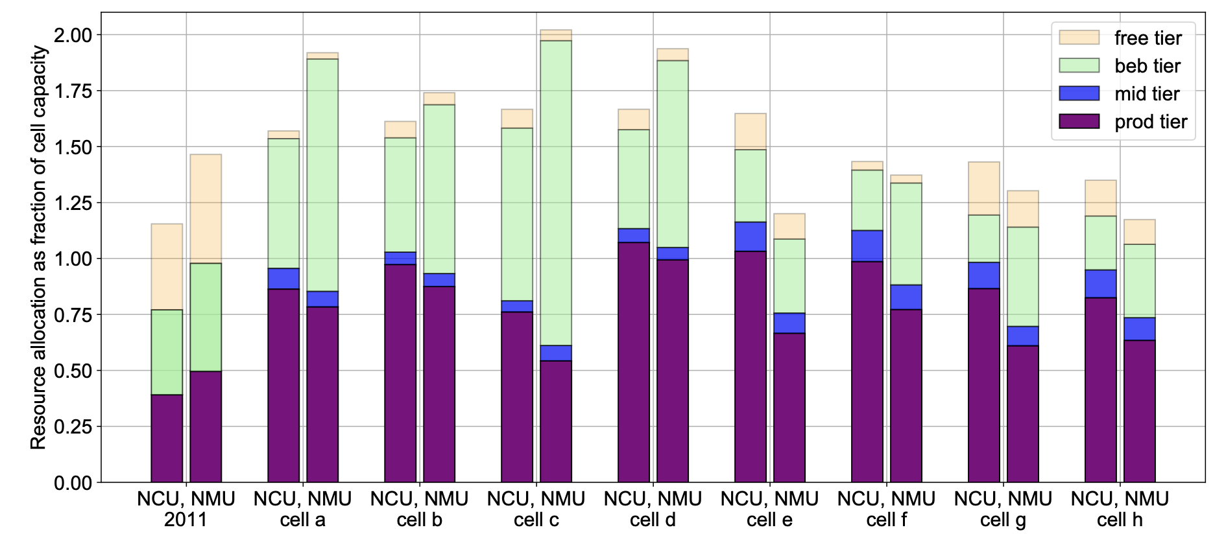
About Borg Trace V3
Borg job scheduling information from 8 different Google Borg cells for the month of May 2019
1000X larger than Trace V2 in 2011
Each cell contains an average of 350 GiB of compressed data stored in Big Query
Internal variation exists on cells
Expect sample’s discrepancy tolerated by tremendous size
Figure. Average utilization (Top) & Allocation (Bottom) as a fraction of cell capacity across the entire trace duration by tier

Slide 7
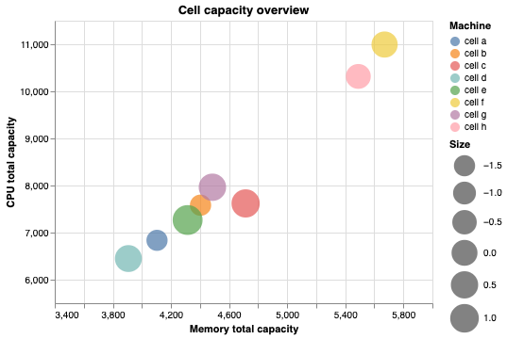
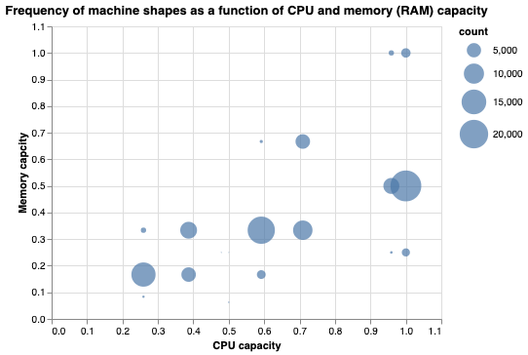
8 Cells’ Capacity Overview

Slide 8
Problem Addressed
What is observed?
What questions can be answered?
1% of jobs (the “hog”) consumes 99% resources, while 99% of jobs (the “mice”) consumes 1% only
Major implications on scheduler design:
care is needed to insulate the bottom 99 % from top 1 % to keep queueing times under control
Both compute and memory consumption follow power-law Pareto distributions with very heavy tail
High degree of heterogeneity and dynamism in the workloads cause difficulty to achieve accurate visibility into future resource demands
Is the insulation of mice and hog categorization intuitive and necessary?
Do we need more label to separate major workloads?
How to make accurate prediction in degree of heterogeneity and dynamism in the workloads?
Can categorization help with resource prediction?

Slide 9
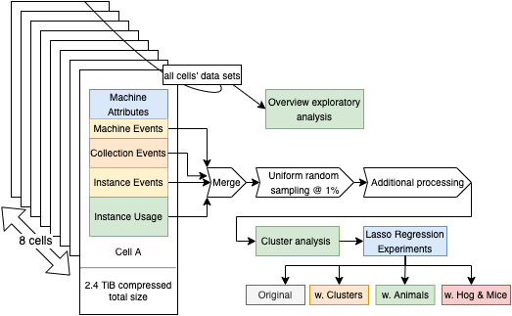
Data Process Pipeline
Figure. An overview of data process pipeline

Slide 10
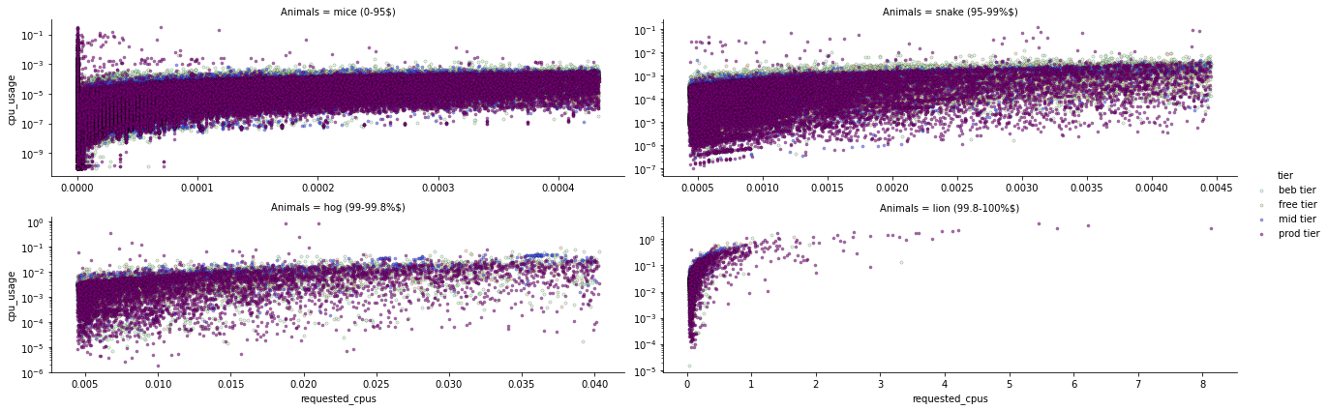
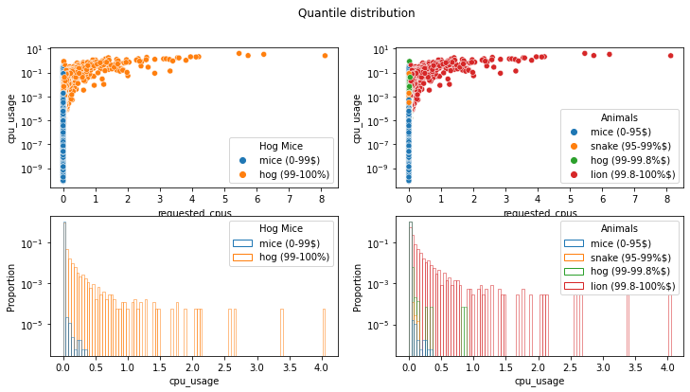
Sample Data Overview
Notes:
Similar trace is observed

Slide 11
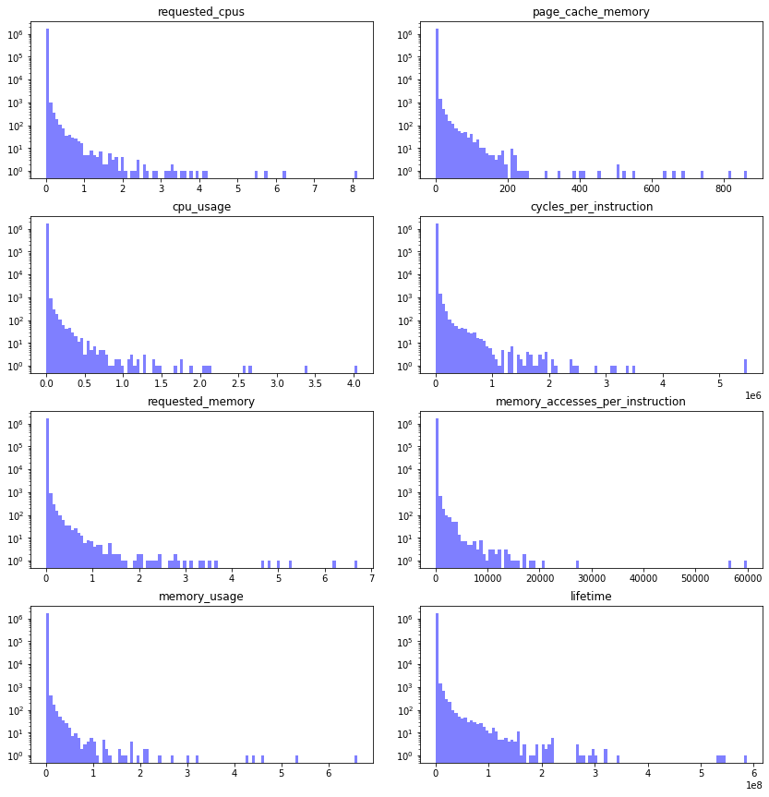
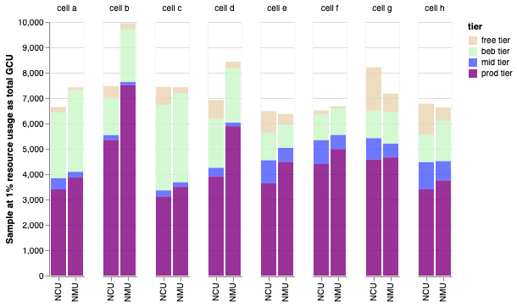
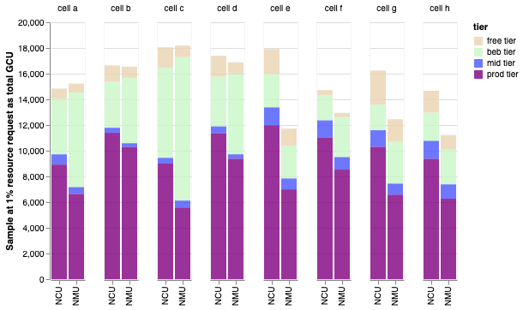
About Sample Data
Figure. Total usage (Top) & request (Bottom) as a fraction of 0.1% cell capacity among sample jobs by tier
Notes:
Similar trace is observed

Slide 12
Conclusion & Experiments

Slide 13
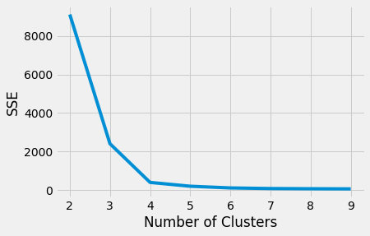
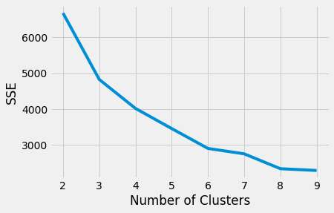
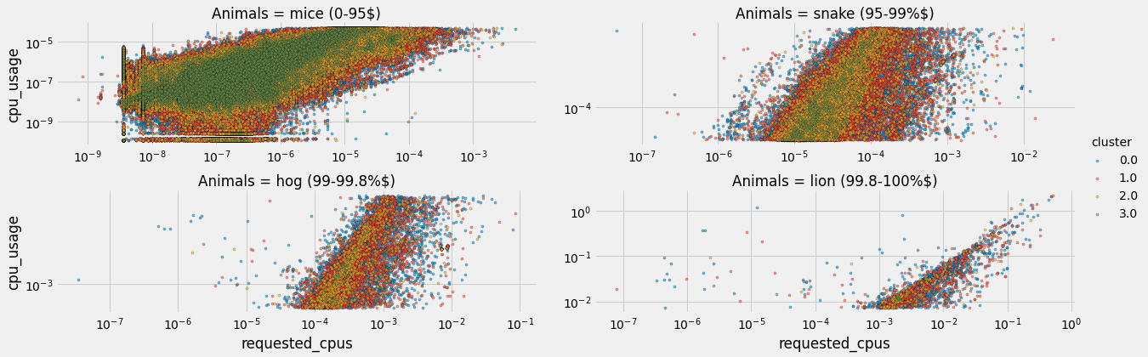
Cluster Analysis
K-means
K-mode
Use only numeric features
Elbow found at 4 clusters
Cluster have better distribution of resources across tiers & percentiles
Sample w. 10,000
Consider both categorical and numeric features
Elbow found at 8 clusters
Perform worse than K-means

Slide 14
Regression Prediction Analysis

Slide 15
Autopilot Prediction

Slide 16
“Thank Y’all!”

